Slide 1





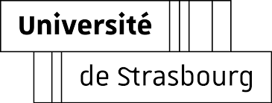

Optimal Exclusive Perpetual Grid Exploration by Luminous Myopic Opaque Robots with Common Chirality
Quentin Bramas, Stéphane Devismes, and Pascal Lafourcade

Slide 2
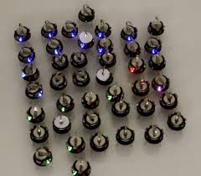
Question(s)
How a very few very weak robots can collaborate to solve an infinite task?
How robot skills influence the task resolution?
Case Study: Exclusive Perpetual Exploration of a grid by a swarm of luminous myopic opaque robots with a common chirality

Slide 3
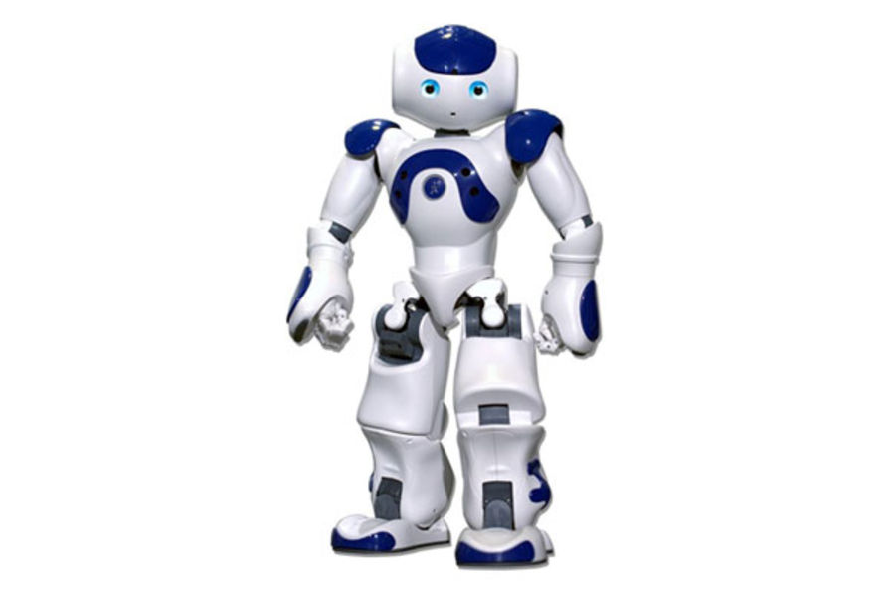
A finite number of robots

Slide 4
Exploring a rectangular area

Slide 5
Exploring a discrete space: an anonymous grid

Slide 6
Exploring a discrete space: an anonymous grid

Slide 7
Robot skills: lights [Peleg, IWDC, 2005]
Each robot has a light with a constant number colors

Slide 8
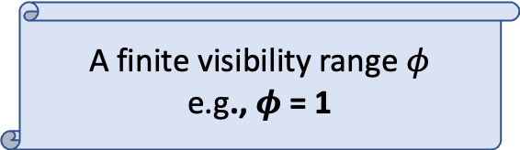
Robot skills: visibility
A finite visibility range $φ$
e.g., $φ$ = 1

Slide 9
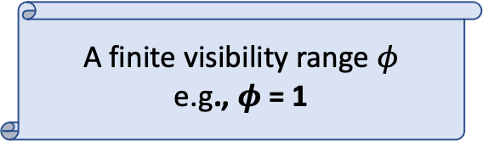
Robot skills: visibility
A finite visibility range $φ$
e.g., $φ$ = 1

Slide 10
Robot skills: mobile

Slide 11
Robot skills: mobile

Slide 12
Robot skills: mobile

Slide 13
Robot skills: mobile
However, exclusiveness:
No two robots are simultaneously at the same place
No two robots traverse the same edge simultaneously

Slide 14
Robot skills: no compass

Slide 15
Robot skills: a common chirality

Slide 16


Robot skills: a common chirality
$$π/2$$
$$−π/2$$

Slide 17
Other weaknesses
Opaque
No additional persistent memory (one color = oblivious)
No direct communication mean (deaf mute)
No whiteboard on nodes
No pebble …

Slide 18
Execution Model [Suzuki & Yamashita, SIAM Jrnl of Comp., 1999]
Look-Compute-Move Cycles

Slide 19
Execution Model [Suzuki & Yamashita, SIAM Jrnl of Comp., 1999]
Look-Compute-Move Cycles (here at distance 1)

Slide 20
Execution Model [Suzuki & Yamashita, SIAM Jrnl of Comp., 1999]
Look-Compute-Move Cycles (destination + color)

Slide 21
Execution Model [Suzuki & Yamashita, SIAM Jrnl of Comp., 1999]
Look-Compute-Move Cycles

Slide 22
Execution Model [Suzuki & Yamashita, SIAM Jrnl of Comp., 1999]
Look-Compute-Move Cycles

Slide 23
Synchrony Refinements
Asynchronous
Semi-Synchronous
Synchronous
L | C |  | M |  | L |  | C | M | L |  | C
 |  | L |  | C | M | L | C | M |  | L
L | C | M |  |  |  | L | C | M | L | C | M
L | C | M | L | C | M | L | C | M
L | C | M | L | C | M | L | C | M | L | C | M
L | C | M | L | C | M | L | C | M | L | C | M

Slide 24
Synchrony Refinements
Asynchronous
Semi-Synchronous
Synchronous
L | C |  | M |  | L |  | C | M | L |  | C
 |  | L |  | C | M | L | C | M |  | L
L | C | M |  |  |  | L | C | M | L | C | M
L | C | M | L | C | M | L | C | M
L | C | M | L | C | M | L | C | M | L | C | M
L | C | M | L | C | M | L | C | M | L | C | M

Slide 25

Rules and Chirality
=
=
=
$$≠$$
=
=
=

Slide 26


Deterministic Rules and Chirality

Slide 27
Algorithms
Algorithm = initial configurations + rules
In our algorithms:
  rules are deterministic
  locally-defined initial configurations:
    A pattern, i.e., colors + relative positions of the robots, e.g.,
    The pattern is arbitrarily placed in the grid

Slide 28

Lower Bounds
Any restriction on initial configurations
Nondeterministic rules are allowed
  Nondeterminism solved by an adversary
  But it may help !
  [Bramas et al., FUN’22]

Slide 29

Perpetual Grid Exploration Problem
With n robots
For every grid G=(V,E) of size X$×$Y, with X $≥$n and Y $≥$n, each node of G should be visited infinitely often by a robot.

Slide 30
Overview of the results
Visibility range | # Robots | # Colors | Algorithm
Finite | 1 | Finite | Impossible
Finite | 2 | 1 | Impossible
1 | 2 | 2 | Impossible
1 | 3 | 1 | Impossible
1 | 2 | 3 | Yes
2 | 2 | 2 | Yes
2 | 3 | 1 | Yes

Slide 31
Overview of the results
Visibility range | # Robots | # Colors | Algorithm
Finite | 1 | Finite | Impossible
Finite | 2 | 1 | Impossible
1 | 2 | 2 | Impossible
1 | 3 | 1 | Impossible
1 | 2 | 3 | Yes
2 | 2 | 2 | Yes
2 | 3 | 1 | Yes

Slide 32
Overview of the results
Visibility range | # Robots | # Colors | Algorithm
Finite | 1 | Finite | Impossible
Finite | 2 | 1 | Impossible
1 | 2 | 2 | Impossible
1 | 3 | 1 | Impossible
1 | 2 | 3 | Yes
2 | 2 | 2 | Yes
2 | 3 | 1 | Yes

Slide 33
Overview of the results
Visibility range | # Robots | # Colors | Algorithm
Finite | 1 | Finite | Impossible
Finite | 2 | 1 | Impossible
1 | 2 | 2 | Impossible
1 | 3 | 1 | Impossible
1 | 2 | 3 | Yes
2 | 2 | 2 | Yes
2 | 3 | 1 | Yes

Slide 34
Overview of the results
Visibility range | # Robots | # Colors | Algorithm
Finite | 1 | Finite | Impossible
Finite | 2 | 1 | Impossible
1 | 2 | 2 | Impossible
1 | 3 | 1 | Impossible
1 | 2 | 3 | Yes
2 | 2 | 2 | Yes
2 | 3 | 1 | Yes

Slide 35
Overview of the results
Visibility range | # Robots | # Colors | Algorithm
Finite | 1 | Finite | Impossible
Finite | 2 | 1 | Impossible
1 | 2 | 2 | Impossible
1 | 3 | 1 | Impossible
1 | 2 | 3 | Yes
2 | 2 | 2 | Yes
2 | 3 | 1 | Yes

Slide 36
Overview of the results
Visibility range | # Robots | # Colors | Algorithm
Finite | 1 | Finite | Impossible
Finite | 2 | 1 | Impossible
1 | 2 | 2 | Impossible
1 | 3 | 1 | Impossible
1 | 2 | 3 | Yes
2 | 2 | 2 | Yes
2 | 3 | 1 | Yes

Slide 37
First Solution: range 1, 2 robots, 3 colors
Principle
  Moving group: a leader + a follower
    The follower follows the leader 😉
      It is used to give an orientation to the group
      Color:
    The leader takes the decision on the behalf of the group
      2 colors: (left) , (right)

Slide 38
First Solution: range 1, 2 robots, 3 colors
Initial Configurations:
  Leader:
  Follower

Slide 39
First Solution: range 1, 2 robots, 3 colors
Move toward a wall

Slide 40
First Solution: range 1, 2 robots, 3 colors
Move toward a wall

Slide 41
First Solution: range 1, 2 robots, 3 colors

Slide 42
First Solution: range 1, 2 robots, 3 colors
Turn

Slide 43
First Solution: range 1, 2 robots, 3 colors
Turn

Slide 44
First Solution: range 1, 2 robots, 3 colors
Move toward a wall

Slide 45
First Solution: range 1, 2 robots, 3 colors
Turn

Slide 46
First Solution: range 1, 2 robots, 3 colors
Turn

Slide 47
First Solution: range 1, 2 robots, 3 colors

Slide 48
First Solution: range 1, 2 robots, 3 colors

Slide 49
First Solution: range 1, 2 robots, 3 colors

Slide 50
First Solution: range 1, 2 robots, 3 colors

Slide 51
First Solution: range 1, 2 robots, 3 colors

Slide 52
First Solution: range 1, 2 robots, 3 colors
And so on …

Slide 53
Optimality
1 robot
#color: finite
Visibility range: finite
Impossible

Slide 54
Optimality
1 robot
#color: finite
Visibility range: finite
  In a large enough grid,
  when the robot reaches a center
  it sees no wall

Slide 55
Optimality
1 robot
#color: finite
Visibility range: finite
The robot may alternate between 2 positions

Slide 56
Optimality
1 robot
#color: finite
Visibility range: finite
The robot may alternate between 2 positions

Slide 57
Optimality
2 robots
1 color
Visibility range: finite
Impossible

Slide 58
Optimality
2 robots
1 color
Visibility range: finite
  In a large enough grid,
  a robot eventually reaches a center where it sees no wall

Slide 59
Optimality
2 robots
1 color
Visibility range: finite
It may alternate between 2 positions until seing the second one

Slide 60
Optimality
2 robots
1 color
Visibility range: finite
Once robots sees each others, the middle becomes invariant

Slide 61
Optimality
2 robots
1 color
Visibility range: finite
They eventually move in opposite directions (to visit new nodes)

Slide 62
Optimality
2 robots
1 color
Visibility range: finite
Eventually each robot sees neither a wall not the other robot
They can stay isolated forever while alternating between two positions

Slide 63
Optimality
2 robots
2 colors
Visibility range: 1
While a wall is not reached,
they should stay grouped
with different colors
(otherwise similar to previous cases)

Slide 64
Optimality
2 robots
2 colors
Visibility range: 1
Until reaching a wall, they move in one direction
(n.b., if they change their color, they are trapped into 3 nodes)

Slide 65
Optimality
2 robots
2 colors
Visibility range: 1

Slide 66
Asynchronous Version
Visibility range 2
Similar principles, yet sequentialization
  The leader executes as in the synchronous version
  The follower waits until being at distance 2 before following the leader

Slide 67
Asynchronous Version
Visibility range 2
Similar principles, yet sequentialization
  The leader executes as in the synchronous version
  The follower waits until being at distance 2 before following the leader

Slide 68
Asynchronous Version
Visibility range 2
Similar principles, yet sequentialization
  The leader executes as in the synchronous version
  The follower waits until being at distance 2 before following the leader

Slide 69
Other Solutions
https://bramas.fr/static/ICDCN2021/2-robots-2-colors-range-2.html
https://bramas.fr/static/ICDCN2021/3-robots-1-color-range-2.html

Slide 70
Terminating Variants
F → F₀, F₁, F₂, F₃, F₄
Count the number of times the follower left a corner
Similar to the non-terminating version
  Just implement the counting mechanism
Termination when its state is F₄
https://bramas.fr/static/TCS2021/2-robot-7-colors-terminating.html

Slide 71
Extensions & Perspectives
Without chirality: NETYS’2021
Termination and obliviousness
  with 4 robots, range 2, yet not always locally-defined (journal version). Optimal ?
  https://bramas.fr/static/TCS2021/4-robots-1-color-terminating.html
Higher dimension (3D): FUN’2022
Widely explore the asynchronous case

Slide 72

Thank You!

